Slide 1



HackTrix’24 - NeuroNest
Team Name: 6ixty-4our Bit Coders
Members Name: Devanand K
Srivathsan B
Shyam Kaarthikeyen B
Shivnarayan S
Dinessh V

Slide 2


Introduction
Project Overview
Welcome to NeuroNest – the app designed for children with autism, seamlessly blending play and learning. Dive into creative adventures, skill-boosting games, sensory explorations, and a social learning hub. NeuroNest is crafted for inclusivity, providing a supportive space for every child to thrive. Join us in celebrating your child's unique brilliance – download NeuroNest today for an exciting journey where joy meets learning!

Slide 3
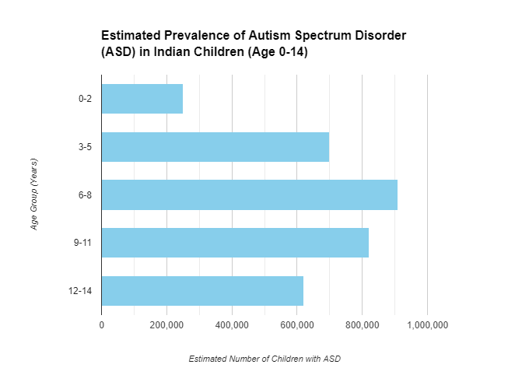
Target Users and market selection
Neuronest is tailored for children with autism, offering a unique blend of play and learning. Our target users are families seeking a supportive and inclusive app for their children.
The market focus is on providing a valuable tool for parents and caregivers looking to enhance the developmental experiences of children with autism.
By creating this app we specifically target children from from age group (3-5) and from age group (6-8) as this is the correct age for the recognition of Autism spectrum Disorder over 700000 children in the age group of 3-5 are affected from Autism and 900000 children from the age group of 6-8 .
It is also clinically proven that early intervention of speech therapy and behavioral therapy helps in the development and mental conditioning .

Slide 4

Problems
Autism is complex; no app, including NeuroNest, is a cure.
Individuals with autism vary; one-size-fits-all apps may not meet individual needs.
Apps are not substitutes for professional guidance and intervention.
Apps can't fully replace real-world social interactions crucial for development.
It's essential to understand that no app, including NeuroNest, can cure autism. Autism is a complex condition that requires a comprehensive approach involving various therapies, education, and professional support. Apps like NeuroNest serve as supportive tools but are not standalone solutions for autism.

Slide 5

Proposed solution
Solution
Neuronest revolutionizes psychological development in children with autism by providing a dynamic and interactive platform. Through engaging activities, it fosters sensory changes, emotional understanding, and essential skill development, ensuring a personalized and effective approach to psychological growth.
Features
1.SWhiteboard for Sensory Stimulation:
Allows children to draw on a virtual whiteboard, providing a dynamic and interactive sensory experience.
Offers a layout for drawing activities that stimulate the senses, contributing to psychological engagement and growth.
Storyboard for Social Learning:
Presents a variety of stories covering everyday life and social cues, including emotions.
Adjustable story speed caters to individual needs, ensuring optimal psychological impact and understanding.
Facial Expression Gamification:
Utilizes gamification to teach and reinforce understanding of facial expressions.
Engages children in a quiz format, prompting them to select the appropriate facial expression, fostering emotional intelligence and psychological growth.
Solution

Slide 6
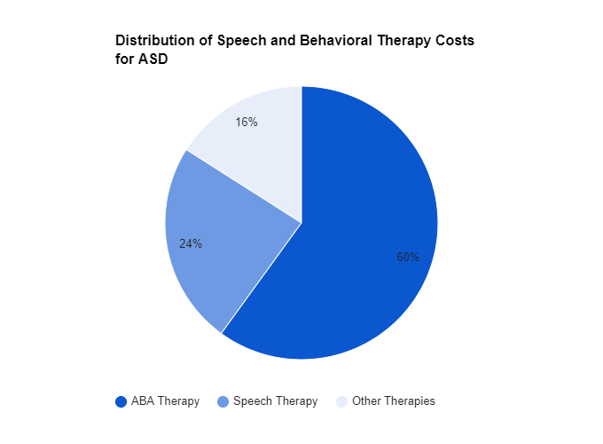
Challenges and Key Learning
Key Learning
Tailoring for Diverse Sensory Needs:
Adapting activities to accommodate a wide range of sensory preferences.
Ensuring inclusivity while addressing various sensory sensitivities.
Iterative testing and user feedback were crucial for refining sensory-stimulating features.
Collaborating with occupational therapists provided insights into effective sensory engagement.
Age-Appropriate Content:
Crafting content that is both engaging and suitable for the age group of 10-14.
Ensuring the content aligns with the cognitive and emotional development of the targeted age range.
Iterative testing and adjustments were essential to gauge age-appropriateness.
Collaboration with child psychologists contributed to creating content aligned with developmental milestones.

Slide 7
Future work
Neuronest plans to enhance its impact by introducing advanced customization, expanding the story library, and incorporating interactive challenges. Scaling initiatives include collaborations with experts, multilingual support, ongoing research, and community feedback integration for continuous improvement and global accessibility.
Explain
Neuronest aims to grow by adding personalized features like advanced drawing layouts and expanding its story library. Scaling plans involve collaborating with experts, supporting multiple languages, ongoing research, and incorporating user feedback for continuous improvement.

Slide 8
⁠Business Model and Monetization
Business Model and Monetization: Neuronest adopts a versatile business model canvas, leveraging partnerships with therapists and educators. Monetization strategies include a freemium model with basic features free and premium features offered through a subscription. The estimated costs involve development, maintenance, and collaboration expenses.
Future Work: Potential Features and Scaling Plans: Future plans for Neuronest encompass advanced customization, expanded story libraries, and interactive challenges. Scaling initiatives include collaborations with experts, multilingual support, ongoing research, and community feedback integration, fostering continuous improvement and global accessibility.

Slide 9
Strategy 1
Neuronest's strategy revolves around redefining the landscape of medical and therapy technology, particularly in the domain of autism intervention. By seamlessly integrating dynamic features like the sensory-stimulating whiteboard, interactive storyboards, facial expression gamification, and essential words for speech therapy, the app ensures a holistic and personalized approach. This not only engages children effectively but also enhances their psychological development.
The key strategy lies in empowering parents with a user-friendly platform for early intervention. Neuronest's intuitive design allows parents to actively participate in their child's development, fostering a collaborative approach with therapists. Through daily activities that blend seamlessly into a child's routine, parents become instrumental in providing consistent support. The app's scalability ensures accessibility to a global audience, democratizing early intervention and revolutionizing the paradigm of medical and therapy technology for autism. Neuronest strategically positions itself as a transformative tool, bridging the gap between professional therapy and parental involvement for impactful early intervention.
Conclusion
(Recap & acknowledgments)
Neuronest stands as a revolutionary force in medical and therapy technology, redefining autism support with its dynamic, interactive features. Its innovative approach fosters personalized, effective, and engaging interventions for children's psychological growth.

Slide 10
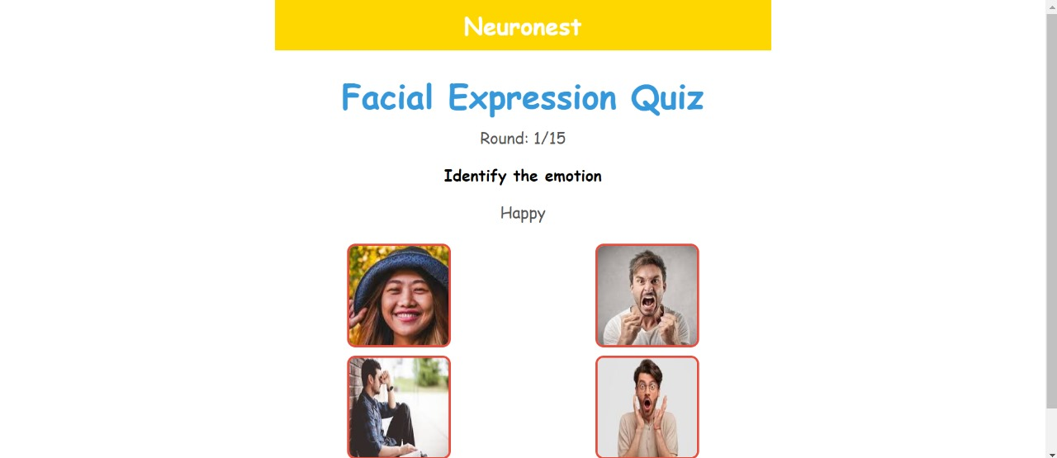
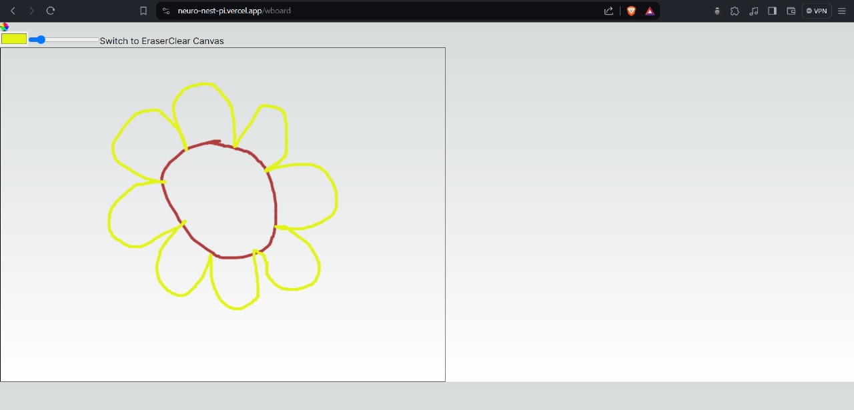
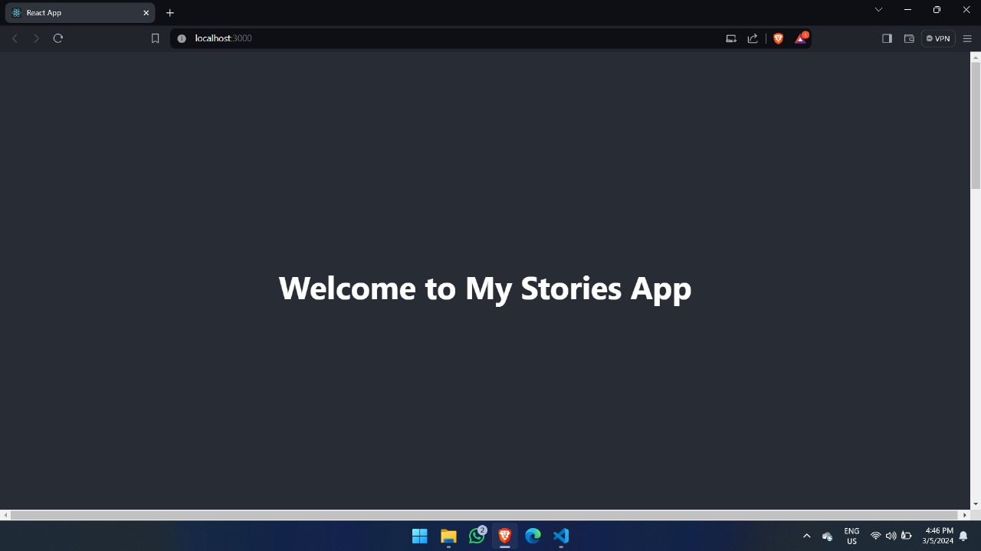
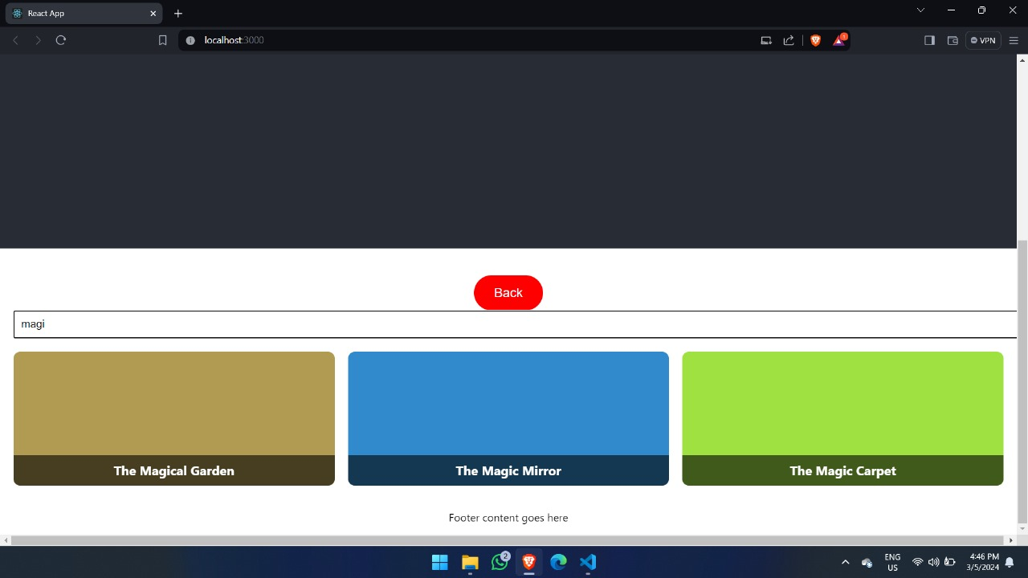
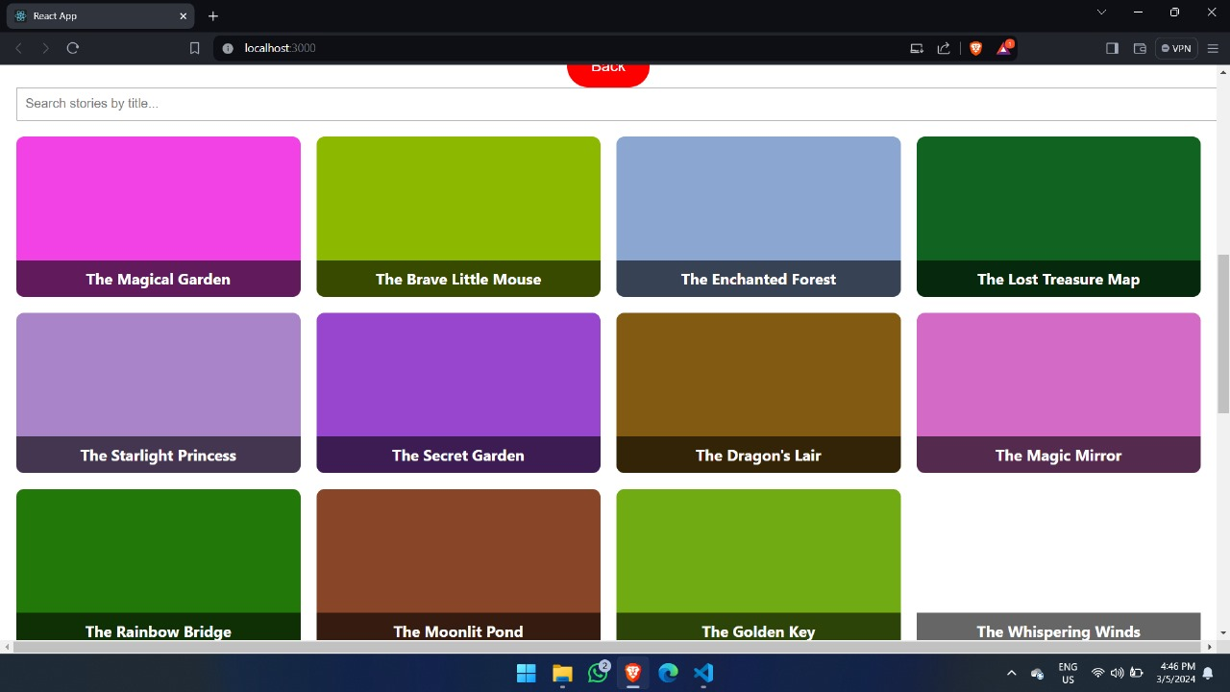
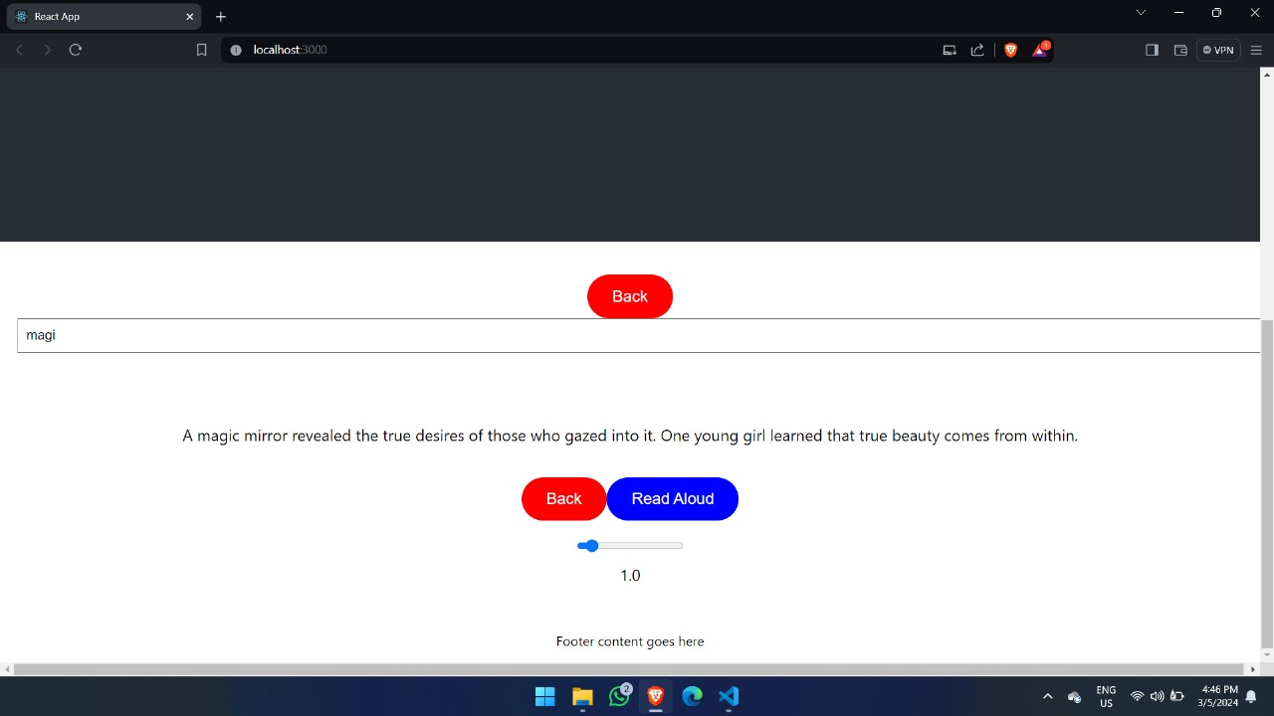
prototype working

